Slide 1

AI and Machine Learning for IoT Big Data

Slide 2
Basics of Big Data

Slide 3
Outline of the lecture
Big Data (BD) is becoming increasingly important in many areas, since it makes available previously inaccessible information, and insights from that can change profoundly almost any fields.
Big Data is now used by most large enterprises, and small to medium companies are also getting involved.

Slide 4
Outline of the lecture
But BD requires new technologies and skills, so that the important parts of information, hidden in huge volumes of noise, could be mined out.
This lecture introduces some basic BD concepts, tools, and gives leads for further study.

Slide 5
Where are we in the Course?
Introduction: Background of IoT, Big Data, AI
Collect, analyze data from IoT on a large scale
Elements and practice of statistics
AI methods for data science
Getting further with AI: internal workings
Practical usage of AI for Big Data from IoT
Moving into the real world

Slide 6
Lecture 2: Big Data basics
Motivation, general characteristics of BD
Apache Hadoop and Spark
PySpark vs. Scala
Creating a Spark cluster
Accessing and processing
Example:
Topics for study

Slide 7
Motivation
Data bigger than local storage
Analysis requiring huge computing power
Redundancy: cluster components will fail
Parallel access: same data, different uses
Virtualization: removing dependence on physical computing environments
Notes:
Discuss differences with traditional data analysis
What happens if not all conditions apply? e.g. the data is not huge but we want redundancy, parallel access?
What is the difference with super-computers used for weather prediction, climate change research, particle physics?

Slide 8
The “6 Vs” of Big Data in IoT
• Volume: Data volume is a determining factor to consider an IoT dataset as big data or traditional massive/ very large data. • Velocity: The rate of IoT big data production and processing is high enough to support the availability of big data in real-time. This justifies the needs for advanced tools and technologies for analytics.
Deep Learning for IoT Big Data and Streaming Analytics: A Survey
Mehdi Mohammadi, Graduate Student Member, IEEE, Ala Al-Fuqaha, Senior Member, IEEE, Sameh Sorour, Senior Member, IEEE, Mohsen Guizani, Fellow, IEEE
https://arxiv.org/pdf/1712.04301.pdf
Notes:
Contrast with traditional data:
Volumes were assumed to be manageable in PC local storage by our statistics software
Velocity: data collection would take months / years (e.g. in medicine), a data analyst (statistician) would get significant time to spend on it

Slide 9
The “6 Vs” of Big Data
• Variety: Generally, big data comes in different forms and types. It may consist of structured, semi-structured, and unstructured data. A wide variety of data types may be produced by IoT such as text, audio, video, sensory data
and so on.
• Veracity: Veracity refers to the quality, consistency, and trustworthiness of the data, which in turn leads to accurate analytics. This property needs special attention to hold for IoT applications, especially those with crowd-sensing data.
Notes:
Contrast with traditional data:
Variety: analysis required good familiarity with the domain, with established data formats and contents
Veracity: much less personal attention can be given to data, weird things can now happen…

Slide 10
The “6 Vs” of Big Data
• Variability: This property refers to the different rates of data flow. Depending on the nature of IoT applications, different data generating components may have inconsistent data flows. Moreover, it is possible for a data source to have different rates of data load based on specific times. For example, a parking service application that utilizes IoT sensors may have a peak data load in rush hours.
Notes:
Contrast with traditional data:
Variability: IoT devices are often ad-hoc, not refined over decades; their design and application is geared to get results quickly, instead of becoming part of the infrastructure and getting used over decades.

Slide 11
The “6 Vs” of Big Data
• Value: Value is the transformation of big data to useful information and insights that bring competitive advantage to organizations. A data value highly depends on both the underlying processes/services and the way that data is treated. For example, a certain application (e.g., medical vital sign monitoring) may need to capture all sensor data, while a weather forecast service may need just random samples of data from its sensors. As another example, a credit card provider may need to keep data for a specific period of time and discard them thereafter.
Notes:
Contrast with traditional data:
we usually assumed that each data point is valuable, as collecting them involved expensive preparations and human labor.
Now we can just spread devices everywhere, stream their data into the cloud, and later decide what is needed and what can be thrown away.
BUT! Many businesses depend vitally on some pieces of IoT data, so even though we throw away some, the part we need is very valuable.

Slide 12

Context for IoT Big Data: the SMACT model
Internet
Social Networks
Big Data Analytics
Learning
Cloud Platforms
Mining
Sensing
Aggregation
IoT
Mining
Mobile Systems
The SMACT technologies
(reference: Big-Data Analytics p.15, Fig.1.7)
Notes:
The SMACT acronym:
Social Networks
Mobile Systems
Analytics
Cloud
IoT
IoT domains: H2T, T2H, T2T

Slide 13
Use Cases
IoT sensor data from farm
GIS data from vehicle fleet
Smart power grid, telemetering
Telemedicine
RFID tracking of products
Notes:
Discuss specific Big Data examples: what data types, timings, extent, usage?
Students should be encouraged to come up with more examples.

Slide 14
Structure of Apache Hadoop Big Data cluster
https://hadoop.apache.org/docs/r1.2.1/hdfs_design.html
The data is distributed over the Datanodes, with replication.
Clients access (read / write) the nodes in parallel.
Overall organization is achieved by the Metadata in the Namenode.
Notes:
See: https://hadoop.apache.org/docs/r1.2.1/hdfs_design.html
The online document needs to be read and understood carefully
Hadoop and HDFS underlies all subsequent work in the course

Slide 15
Apache Spark architecture
Worker
SparkContext
Cluster Manager
Worker
Worker
The data is represented as an RDD (Resilient Distributed Dataset)
Worker tasks access partitions of the RDD
Notes:
Discuss why data needs to be partitioned and distributed
What do we mean by “RESILIENT”? To what?

Slide 16
Spark in more details
https://spark.apache.org/docs/latest/cluster-overview.html
The cluster manager handles assigning worker nodes.
SparkContext communicates directly with the executors
Notes:
Discuss the implications of each application having its own and separate executors:
positive: isolation of applications, no possible direct effect on each other
negative: cannot pass information directly, only through external storage
How does this impact the design of applications?

Slide 17
Using Spark locally
Download and install Spark for your platform
Start the Scala interpreter
Create an RDD
Run Scala commands
Notes:
Instructions in the accompanying Zeppelin notebook
(this is to prepare the students for the exercise session, here only give an outline)
https://docs.scala-lang.org/tutorials/scala-with-maven.html

Slide 18
Example task: Record Linkage
We have a database with records, some of them from the same source
However, they have subtle differences: small pieces missing from addresses, names written with abbreviations, misspellings, etc.
How can we identify and collect linked records?
Test database: “linkage”
Notes:
Give some examples from the textbook about addresses written in different ways, names spelled with initials or spelled out fully
Ask students to give examples from their own experience.
How would they write their own name and address:
on a passport application form?
on a postcard?
on a memo to a friend they ask to come to their house?
on Amazon’s website for sending merchandise?
etc. etc. Spot the subtle variations.

Slide 19
Start Spark, define schema for RDD
import org.apache.spark.sql.{DataFrame, Dataset, Row, SparkSession}
import org.apache.spark.sql.functions._ // for lit(), first(), etc.
case class MatchData(
id_1: Int,
id_2: Int,
cmp_fname_c1: Option[Double],
cmp_fname_c2: Option[Double],
cmp_lname_c1: Option[Double],
cmp_lname_c2: Option[Double],
cmp_sex: Option[Int],
cmp_bd: Option[Int],
cmp_bm: Option[Int],
cmp_by: Option[Int],
cmp_plz: Option[Int],
is_match: Boolean
)
Notes:
Explain the concept of “case class” in Scala

Slide 20
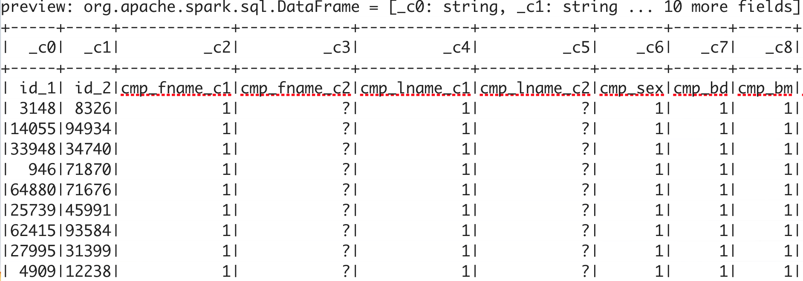
Connect to the RDD, inspect it
import spark.implicits._
val preview = spark.read.csv("linkage")
preview.show()
The head of the raw RDD:
Notes:
The slides show the wide output from Scala in Zeppelin; warn the students that what they see here is only a segment!
When they do the exercises, notice how Scala helps viewing Big Data: never trying to dump millions of lines on the
screen, abbreviating multi-column tables, etc. Remind students again when working with Python (Pandas etc.)
about the same design issues.
In a Zeppelin notebook running Scala, the pre-defined “spark” object will be the start of operations.
Explain the concept of single-assignment “val” values.
Explain the fields:
id_1: the unique ID of user 1
id_2: the unique ID of user 2 (who might be the same as user 1!)
cmp_fname_c1, etc.: comparison results for various characteristics of the two users
Not shown here but will be seen in the notebook: the actual result of “identical” or “not identical”

Slide 21
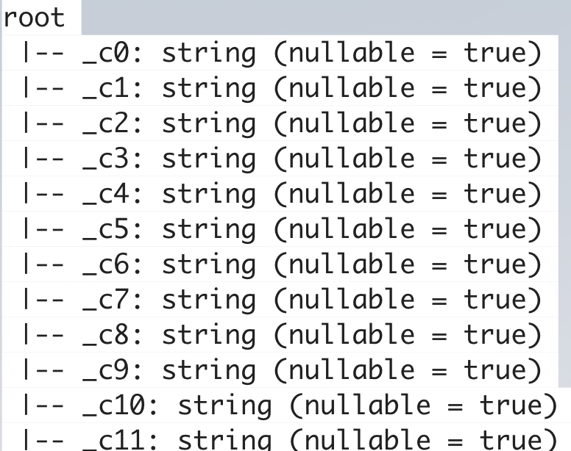
Inspect the RDD (2)
import spark.implicits._
val preview = spark.read.csv("/Volumes/Transcend/DATA/linkage")
preview.show()
preview.printSchema()
The default data structure:
(not what we wanted)
Notes:
The default inferred data type is “string” for everything

Slide 22
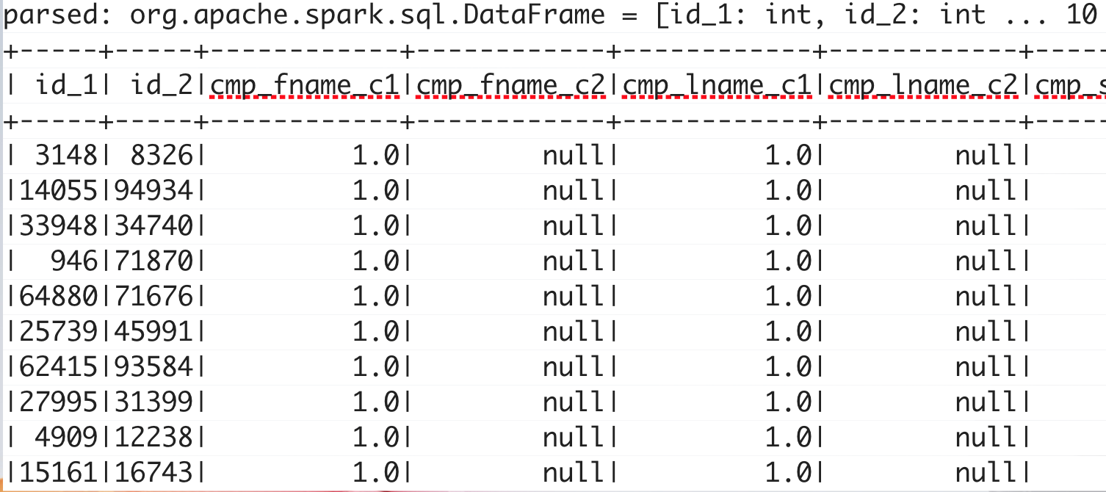
Parse the RDD
val parsed = spark.read
.option("header", "true")
.option("nullValue", "?")
.option("inferSchema", "true")
.csv("/Volumes/Transcend/DATA/linkage")
parsed.show()
Notes:
To get correct data types inferred, we use the method “inferSchema”.
It will inspect the values in each column and assigns the appropriate data type.

Slide 23
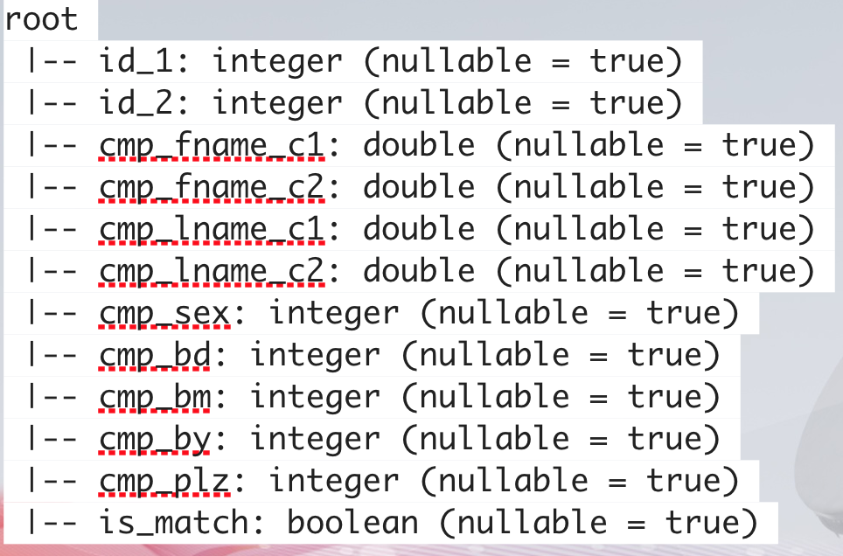
Parse the RDD (2)
val parsed = spark.read
.option("header", "true")
.option("nullValue", "?")
.option("inferSchema", "true")
.csv("/Volumes/Transcend/DATA/linkage")
parsed.show()
parsed.printSchema()
The inferred
data structure:
Notes:
Here are the results of the datatypes found by Spark.
Notice that some are “double” while others are “integer”: the inference is fairly sophisticated.

Slide 24
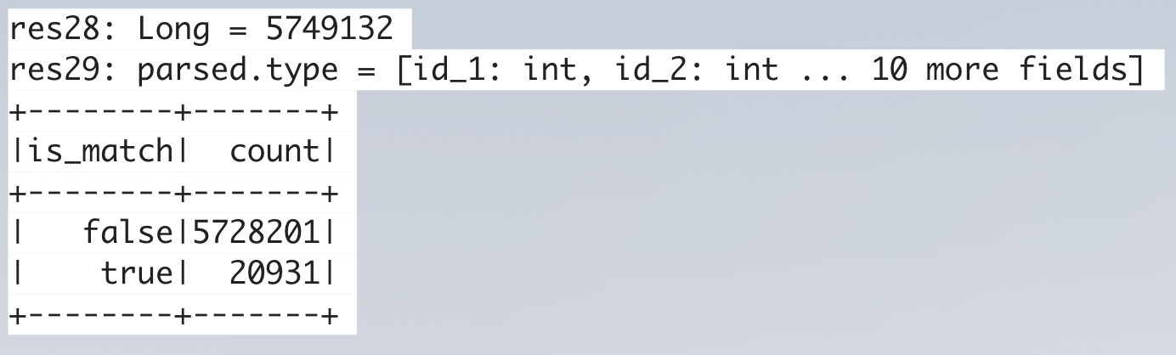
Count the matches in the data
parsed.count()
parsed.cache()
parsed.groupBy("is_match").count().orderBy($"count".desc).show()
Notes:
Explain the operations:
count() -> see result
cache() -> results will be kept in memory until caching is disabled
The next operation is a pipeline, explain each step:
groupBy(“is_match”) -> how many records are labeled “is_match”
count() -> etc. etc.

Slide 25
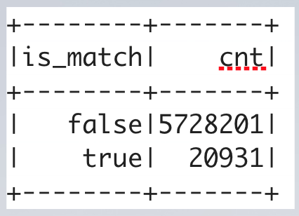
Can do it with SQL
parsed.createOrReplaceTempView("linkage")
spark.sql("""
SELECT is_match, COUNT(*) cnt
FROM linkage
GROUP BY is_match
ORDER BY cnt DESC
""").show()
Notes:
Spark also supports SQL queries; the multi-line quotation is a proper SQL expression sent to Spark.

Slide 26
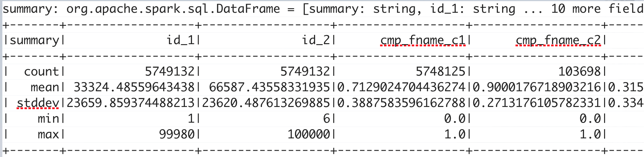
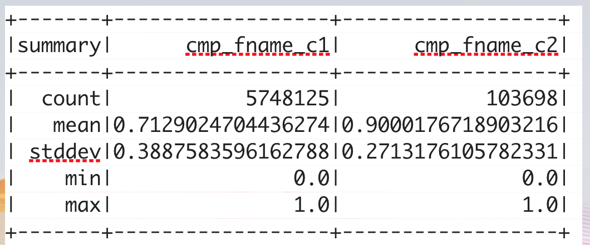
Get description
val summary = parsed.describe()
summary.show()
summary.select("summary", "cmp_fname_c1", "cmp_fname_c2").show()

Slide 27
Define helper functions
def longForm(desc: DataFrame): DataFrame = {
import desc.sparkSession.implicits._ // For toDF RDD -> DataFrame conversion
val schema = desc.schema
desc.flatMap(row => {
val metric = row.getString(0)
(1 until row.size).map(i => (metric, schema(i).name, row.getString(i).toDouble))
})
.toDF("metric", "field", "value")
}

Slide 28
Define helper functions
def pivotSummary(desc: DataFrame): DataFrame = {
val lf = longForm(desc)
lf.groupBy("field").
pivot("metric", Seq("count", "mean", "stddev", "min", "max")).
agg(first("value"))
}

Slide 29
Define helper functions
def crossTabs(scored: DataFrame, t: Double): DataFrame = {
scored.
selectExpr(s"score >= $t as above", "is_match").
groupBy("above").
pivot("is_match", Seq("true", "false")).
count()
}
case class Score(value: Double) {
def +(oi: Option[Int]) = {
Score(value + oi.getOrElse(0))
}
}
def scoreMatchData(md: MatchData): Double = {
(Score(md.cmp_lname_c1.getOrElse(0.0)) + md.cmp_plz +
md.cmp_by + md.cmp_bd + md.cmp_bm).value
}

Slide 30
Use the helper functions
val matchSummaryT = pivotSummary(matchSummary)
val missSummaryT = pivotSummary(missSummary)
matchSummaryT.createOrReplaceTempView("match_desc")
missSummaryT.createOrReplaceTempView("miss_desc")
spark.sql("""
SELECT a.field, a.count + b.count total, a.mean - b.mean delta
FROM match_desc a INNER JOIN miss_desc b ON a.field = b.field
ORDER BY delta DESC, total DESC
""").show()

Slide 31
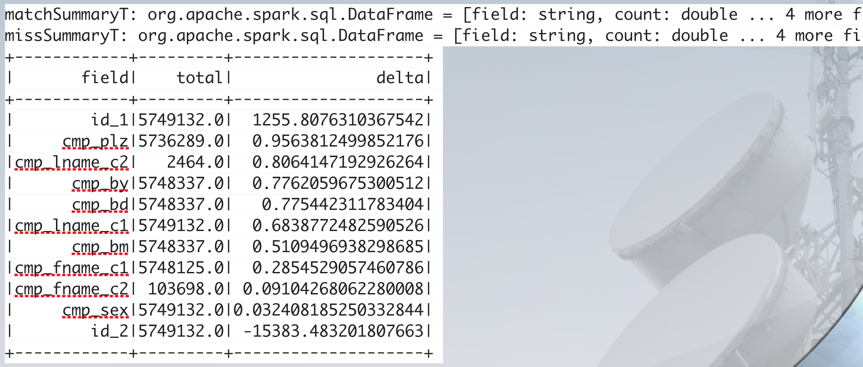
Results of the helper functions

Slide 32
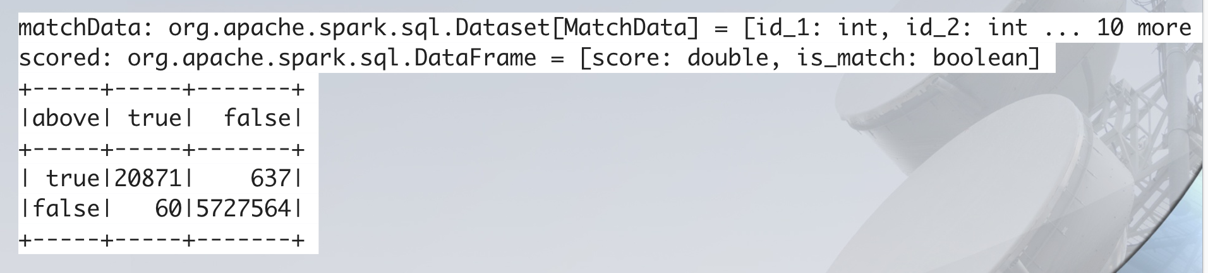
Final result
val matchData = parsed.as[MatchData]
val scored = matchData.map { md =>
(scoreMatchData(md), md.is_match)
}.toDF("score", "is_match")
crossTabs(scored, 4.0).show()
Notes:
How would we proceed to do a full data analysis on the effect of each parameter on finding matches?

Slide 33
Assignment
Find a dataset in CSV form
Place it in a directory where Spark can see it
Open it in Scala
Explore it:
print out a few rows
find the datatype of each column
try to get descriptive statistics
Try to extract interesting information

Slide 34
Summary of the lecture
We have reviewed BD in the SMACT framework, focusing on the “6V”-s common to all BD fields.
We have used the popular Hadoop/Spark data cluster model with Scala to introduce RDD (Resilient Distributed Datasets) and get the first taste of dealing with BD.

Slide 35
Useful links
Hadoop HDFS https://hadoop.apache.org/docs/r1.2.1/hdfs_design.html
Hadoop setup http://shayanmasood.com/blog/how-to-setup-hadoop-on-mac-os-x-10-9-mavericks/
Spark https://spark.apache.org/docs/latest/cluster-overview.html
PySpark http://spark.apache.org/docs/latest/api/python/pyspark.html#pyspark.SparkContext

Slide 36
Summary of the lecture
By actually executing a simple BD processing task, we now have the foundations to proceed to more advanced explorations.
Students are now ready to learn data analysis techniques using local datasets, so that they can transfer the methods to RDDs.

